Slide 1
Session 9!!!
November 30, 2020
Notes:
Names: Hannah, Megan, Zuha, Ana + Paula, Angel, Sasha, Nina

Slide 2
Today’s Agenda
Log On to Arduino web editor
Women-in-Tech Spotlight
Kahoot!
Review of Last Week
- Complete circuit
Activity
Stand ups – anyone who wants to!

Slide 3
Women in Tech Spotlight

Slide 4
Kahoot!

Slide 5
Review of Last Week’s Activity

Slide 6
Servo Motor Exercise
#include <Servo.h> // include the Servo library
Servo myServo; // create a servo object
// set variables
const int potPin = A0;
const int buttonPin = 7;
int potValue = 0;
int servoAngle = 0;
void setup() {
// attaches the servo to pin 9
myServo.attach(9);
// open a serial connection to the comp
Serial.begin(9600);
}
void loop() {
if(digitalRead(buttonPin) == HIGH) { // if the button is pressed:
myServo.write(179); // move the servo to kick the ball
}
else { // the button is not pressed:
potValue = analogRead(potPin); // store the pot value
// scale potentiometer value to the servo
servoAngle = map(potValue, 0, 1023, 0, 179);
myServo.write(servoAngle); // turn the servo to the angle variable
}
Serial.print("potValue: "); // print “potValue” string
Serial.print(potValue); // print the potValue value
Serial.print(", servoAngle: ");
Serial.println(servoAngle);
delay(100); // wait for the servo to get there
}

Slide 7
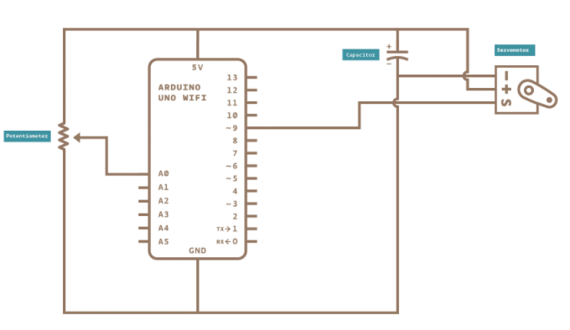
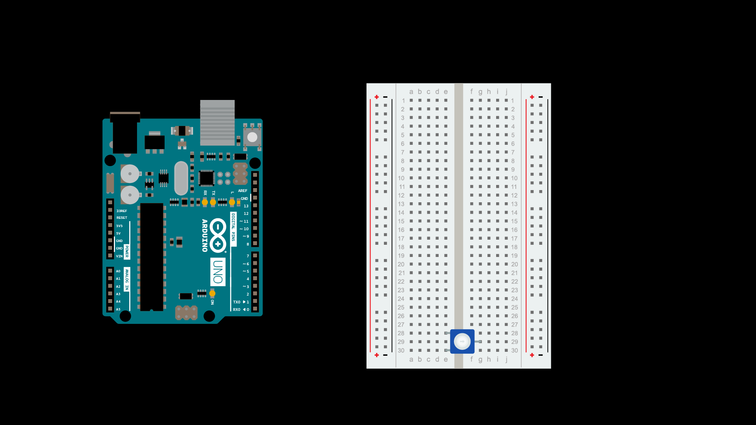
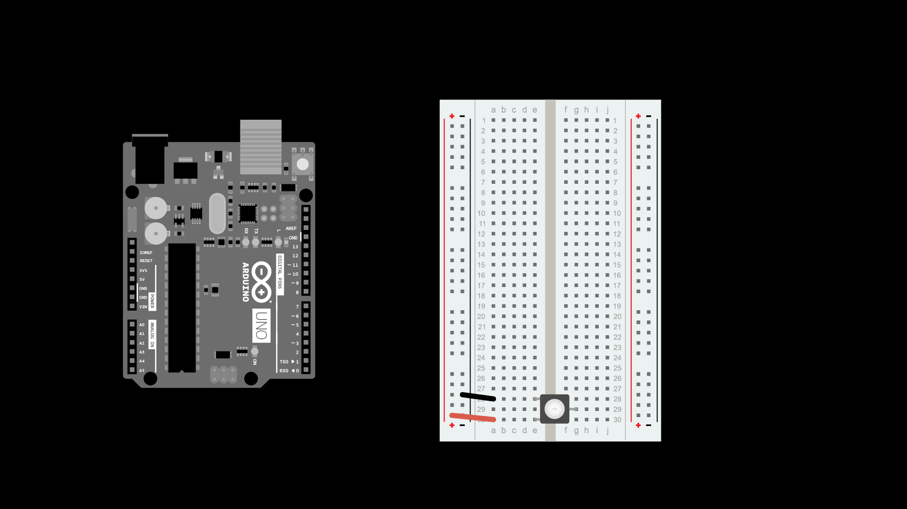
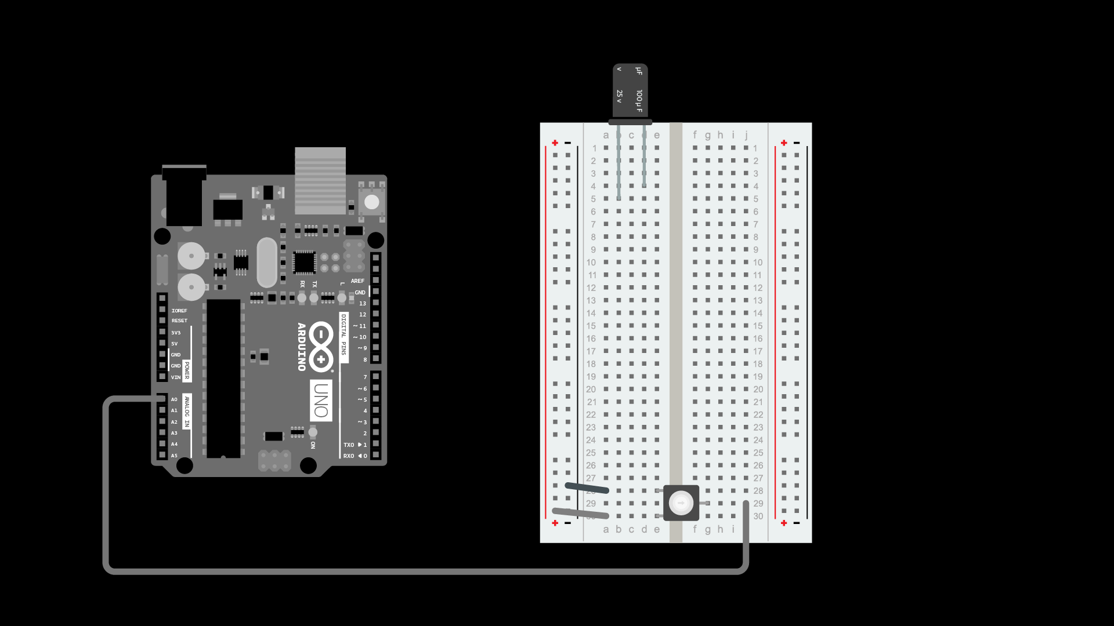
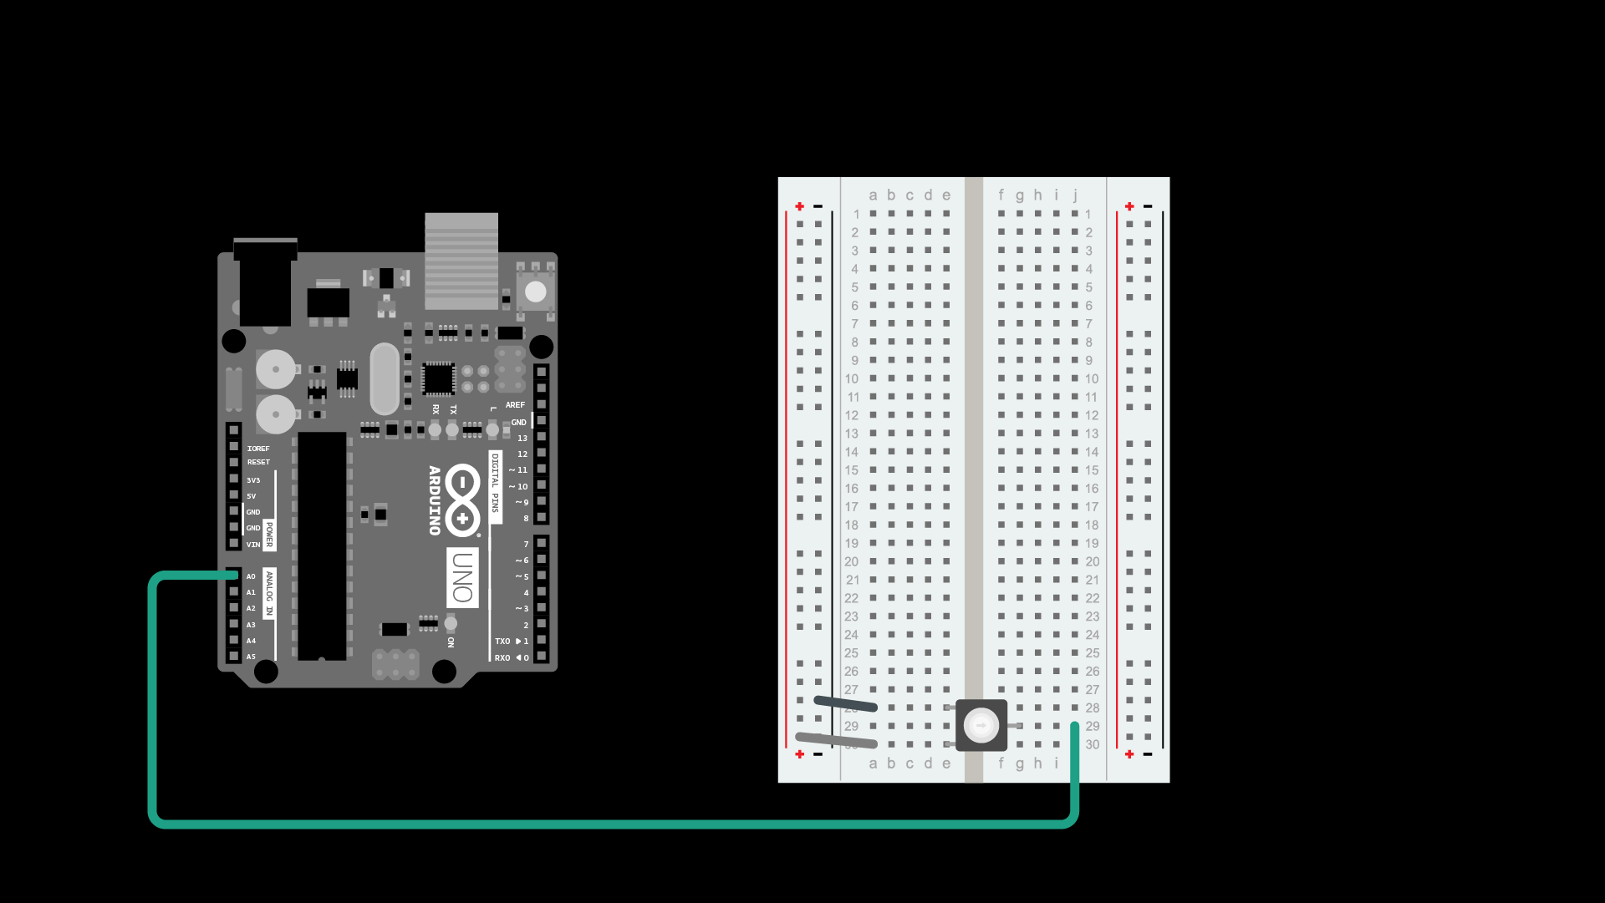
Servo Motor Exercise
1. Connect Potentiometer to breadboard
2. Connect Leads to Potentiometer on breadboard
4. Connect Capacitor to breadboard
3. Connect Potentiometer pin

Slide 8
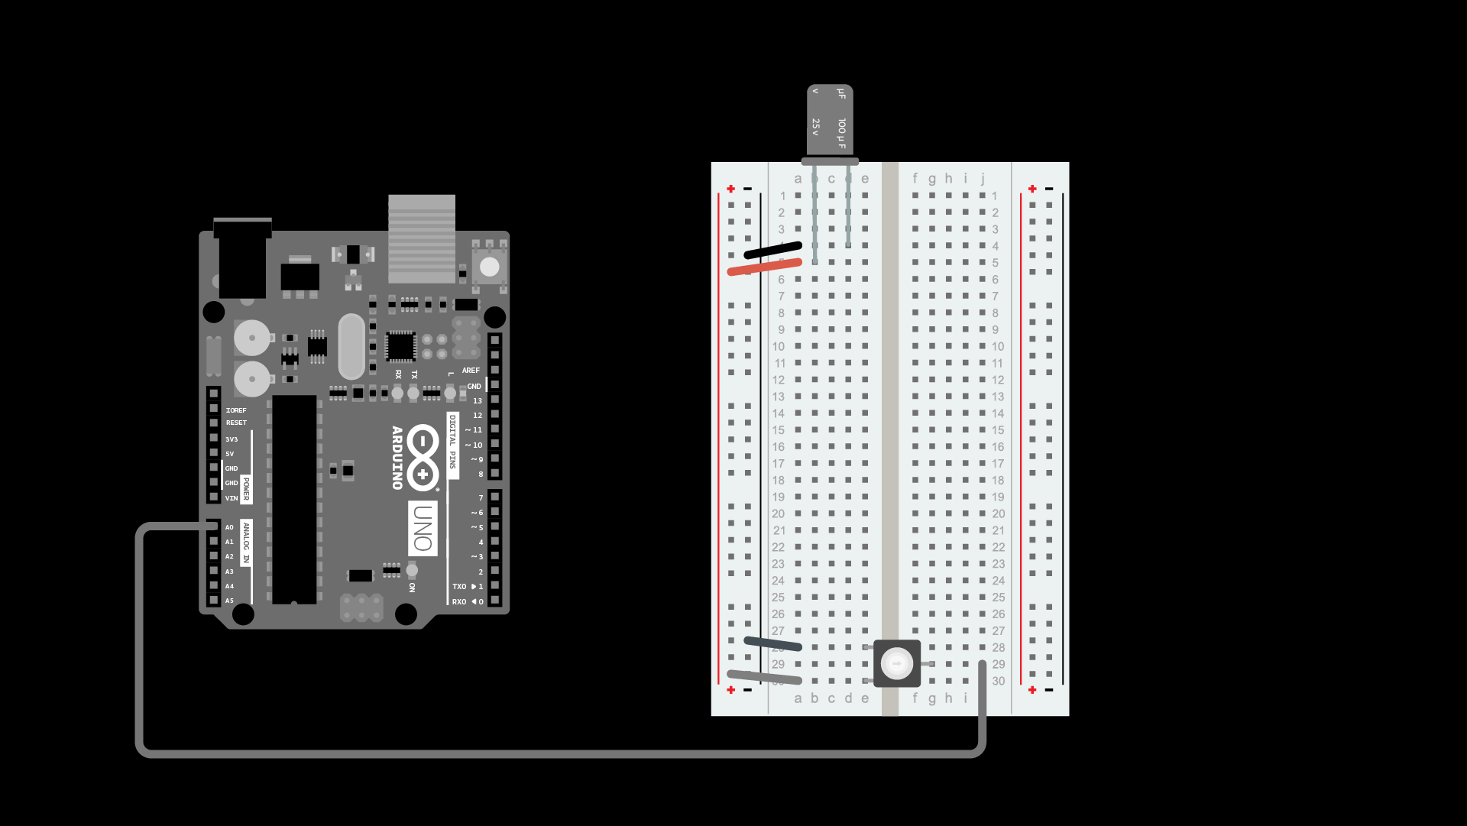
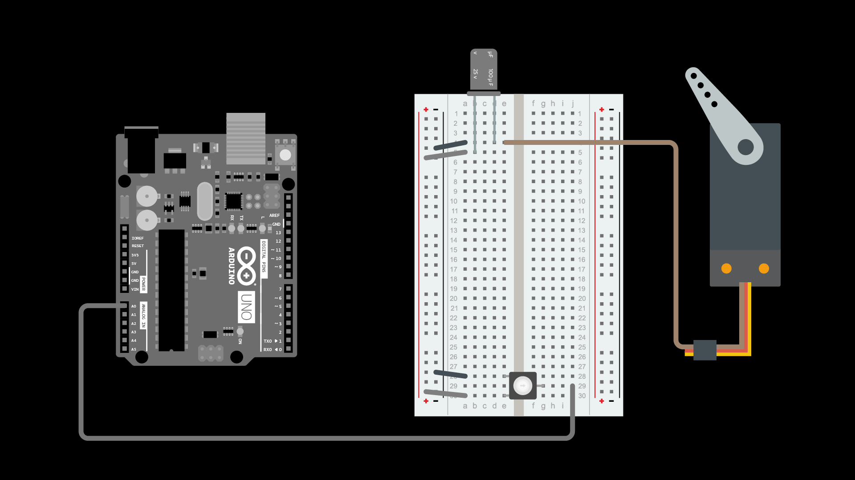
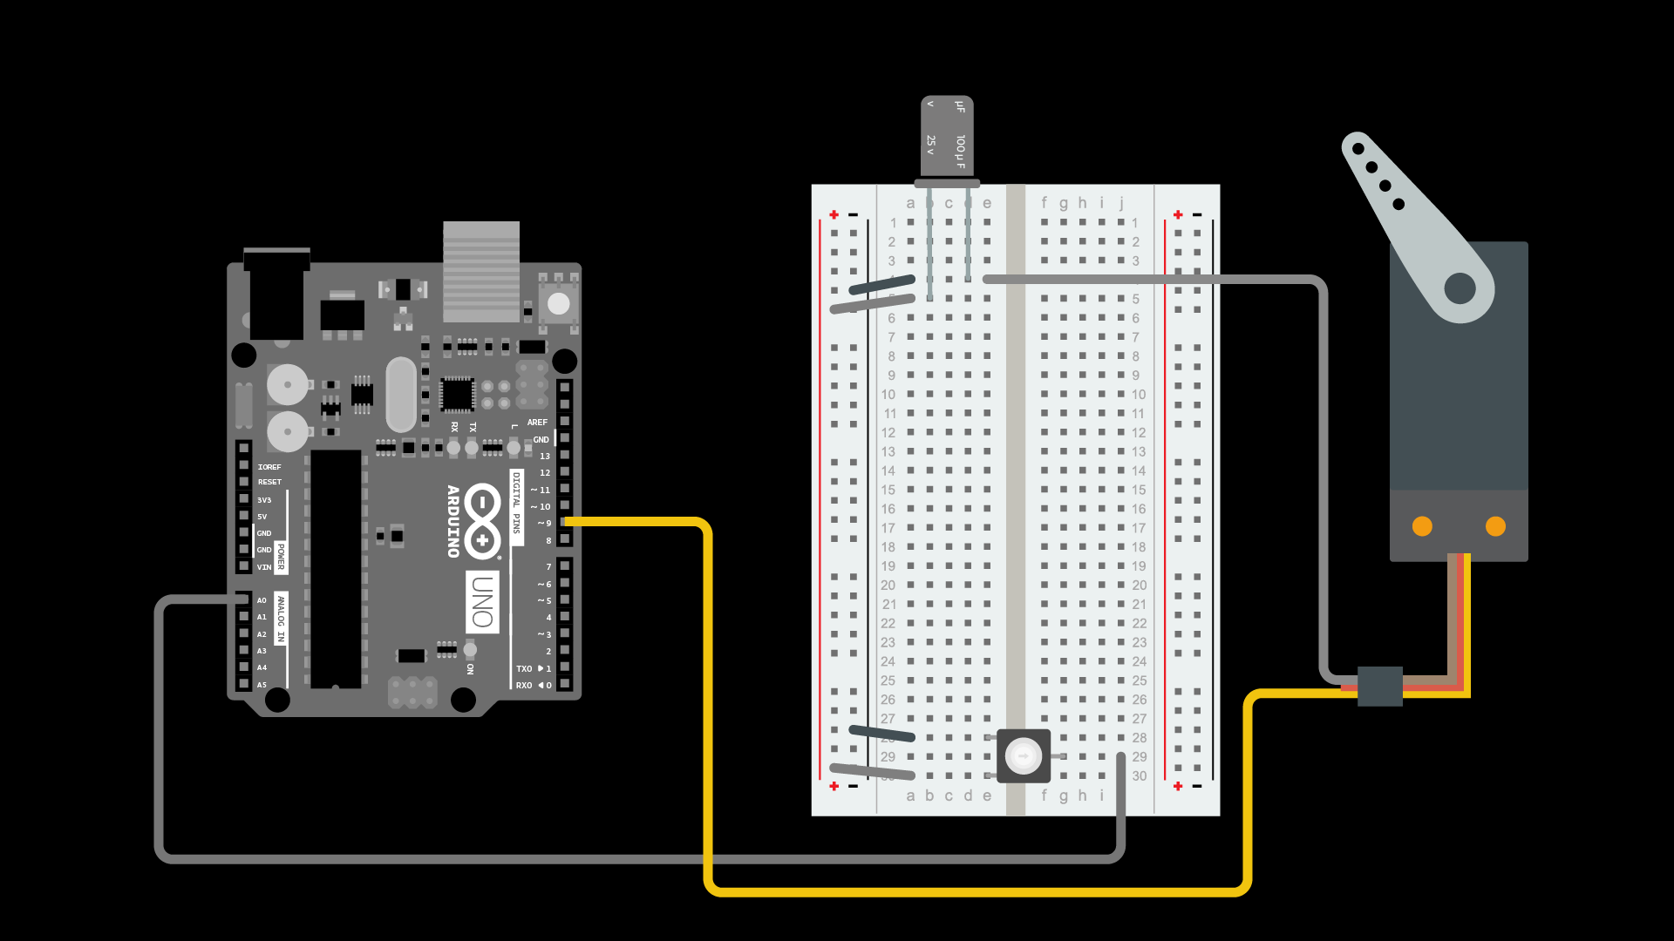
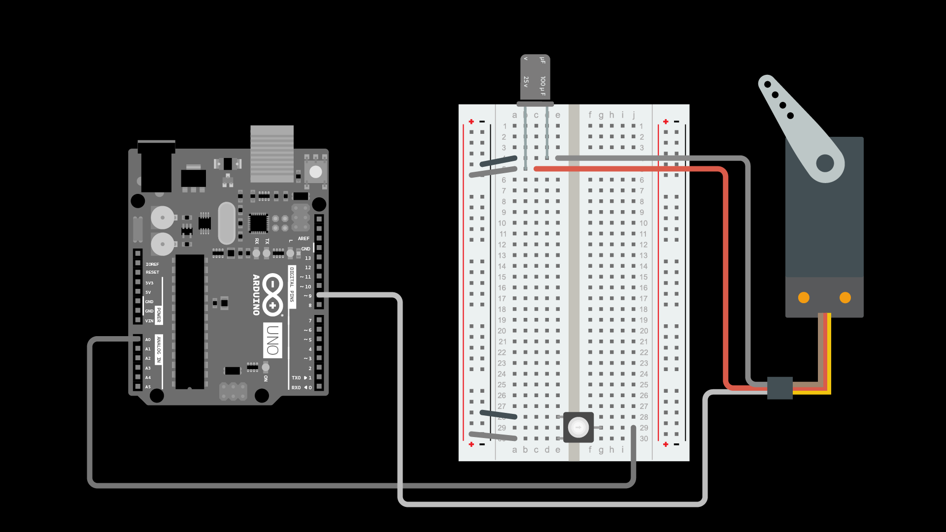
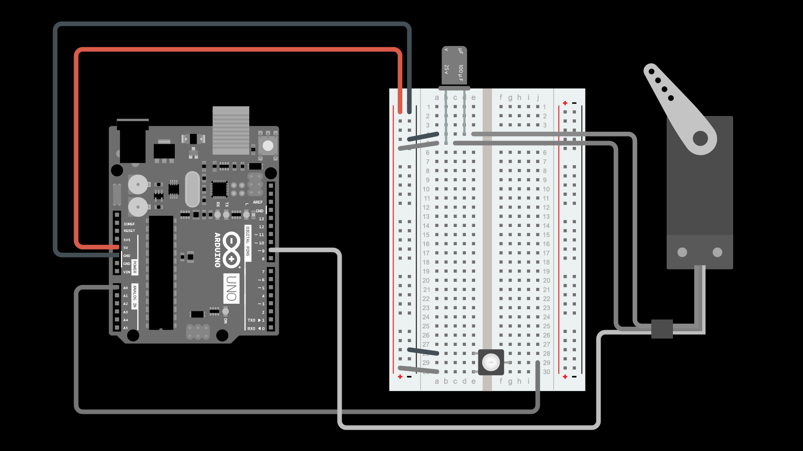
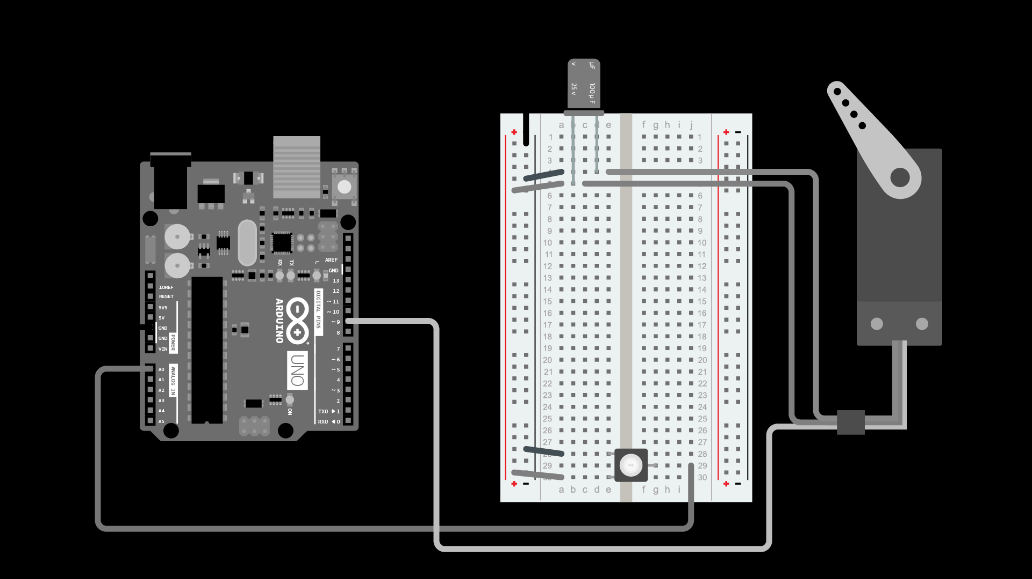
5. Connect Potentiometer leads to breadboard
6. Connect negative motor lead to breadboard
7. Connect motor lead to pin
9. Connect ground
8. Connect positive motor lead to breadboard
10. Connect positive

Slide 9
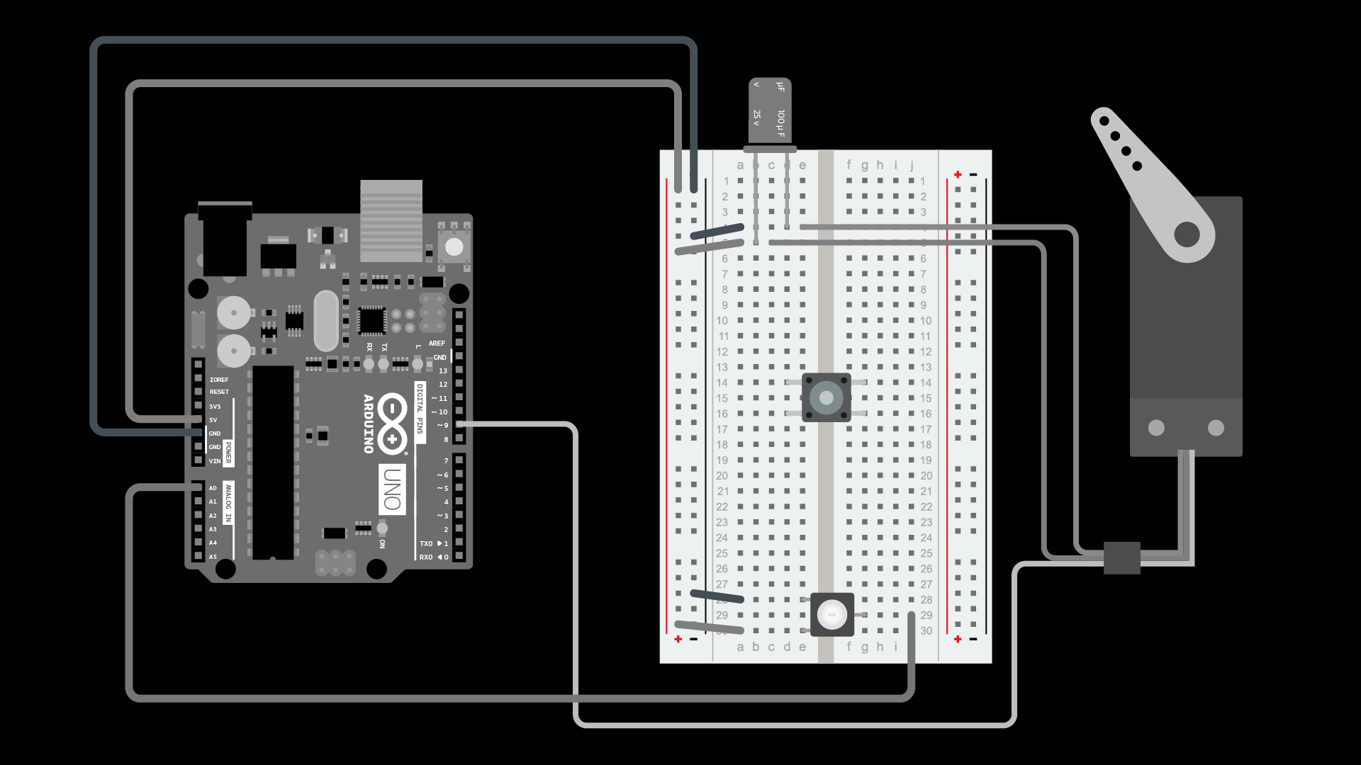
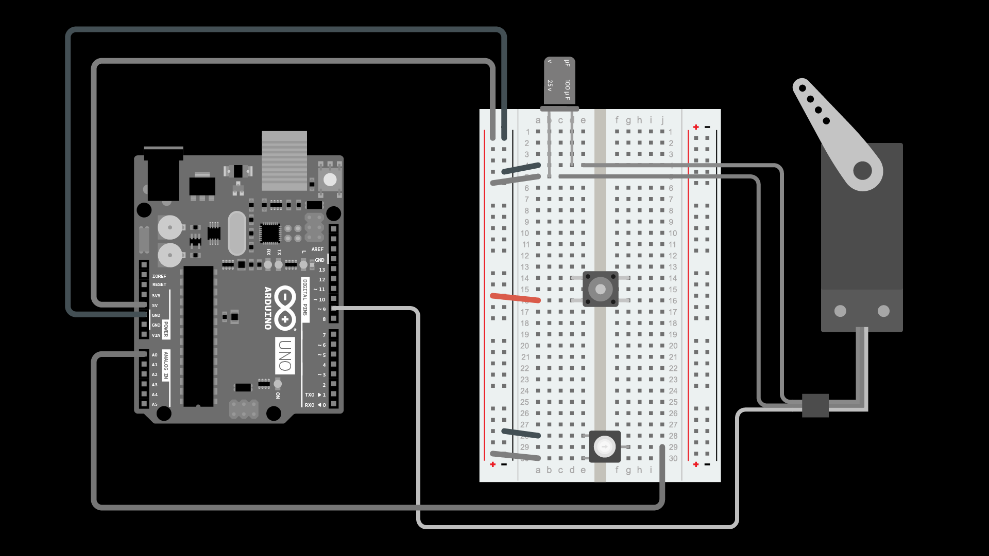

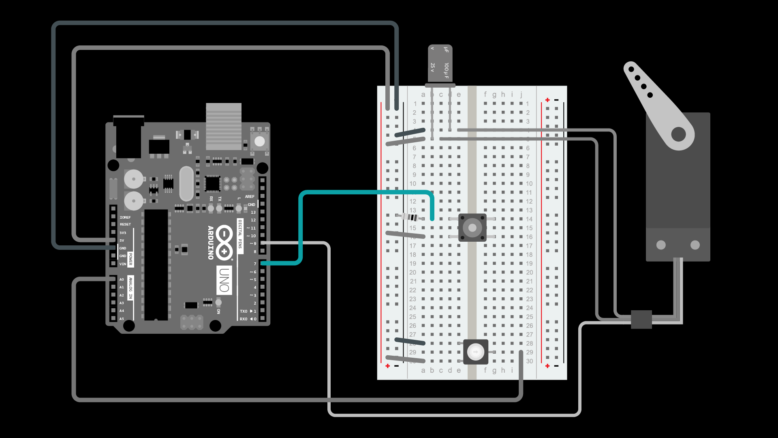
11. Connect button
12. Connect button positive lead
13. Connect button 10 KΩ resistor
14. Connect button to pin

Slide 10
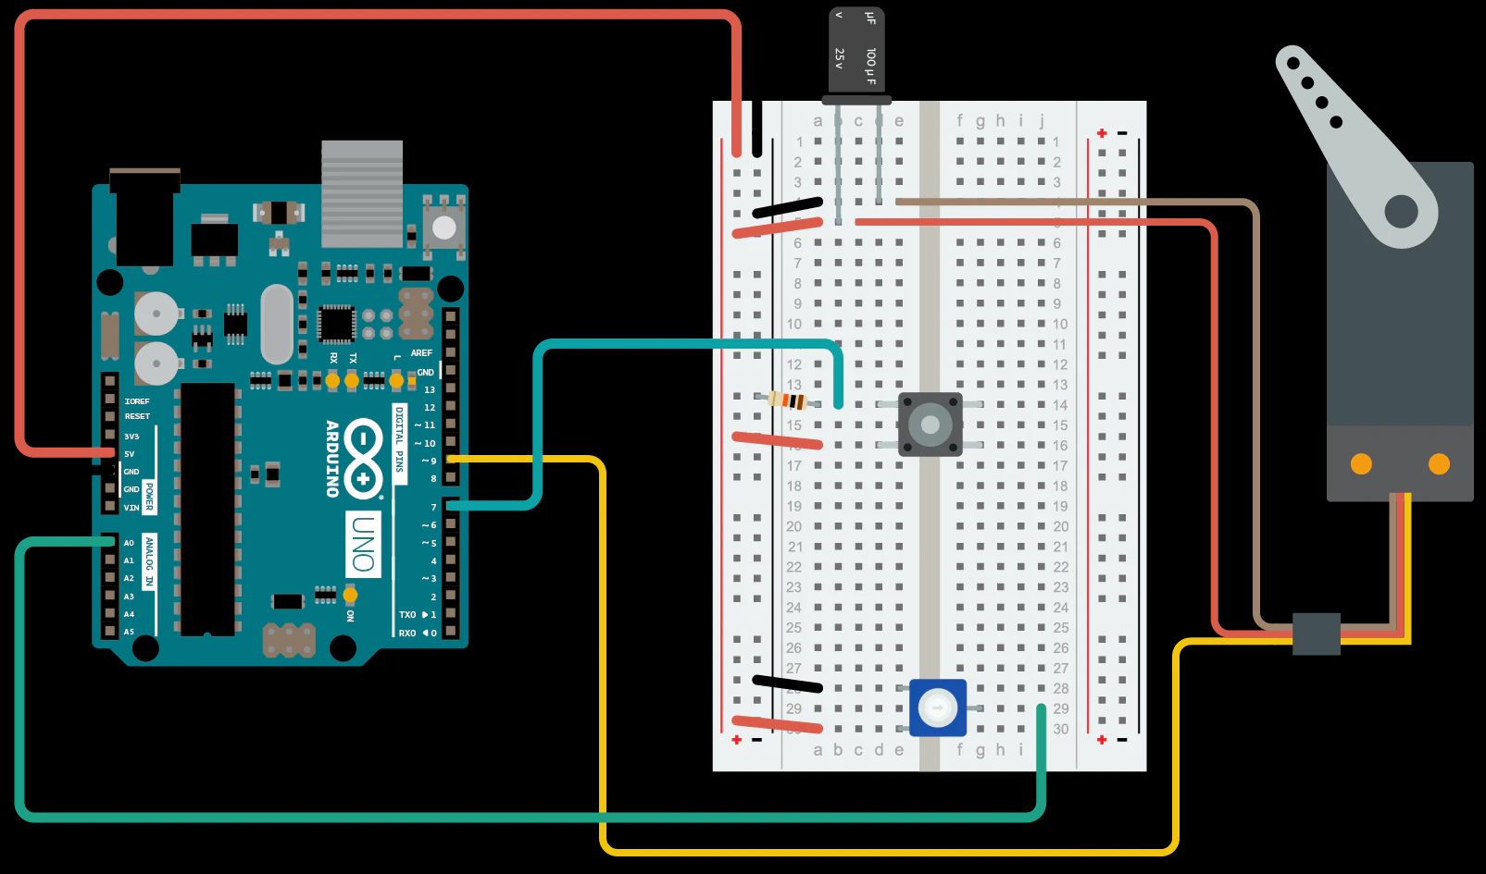

Slide 11
This Week’s Activity
Notes:
https://wcrsyyc.github.io/ardx/circ08.html

Slide 12
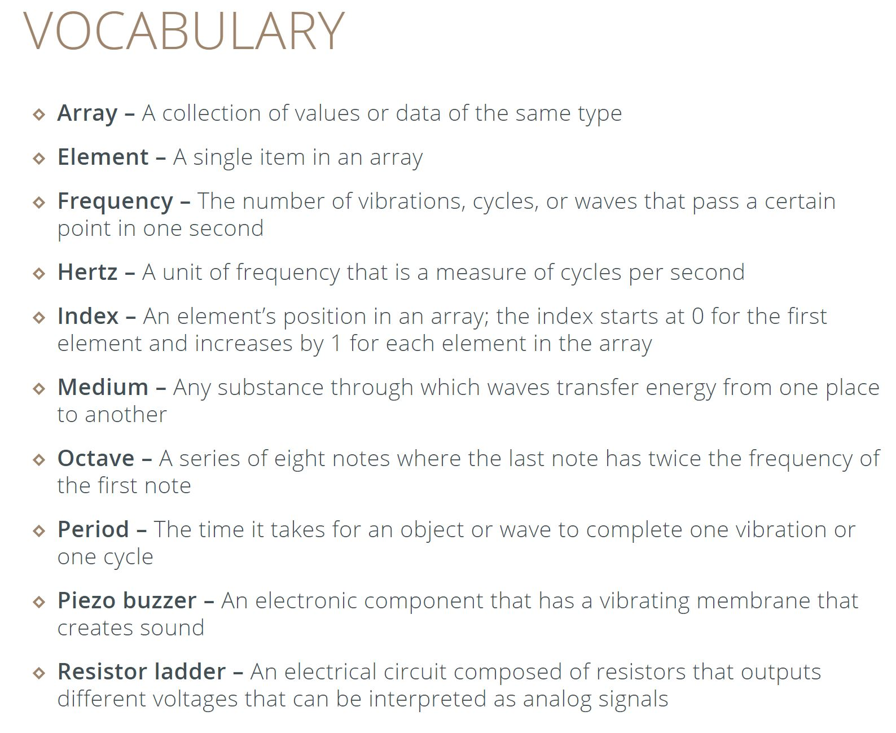

Slide 13
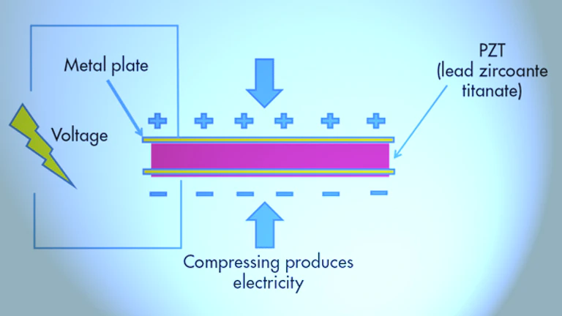
Piezoelectric Effect (PZT)
Piezoelectricity is the electric charge that accumulates in certain solid materials (such as crystals, certain ceramics, and biological matter such as bone, DNA and various proteins) in response to applied mechanical stress. The word piezoelectricity means electricity resulting from pressure and latent heat.

Slide 14
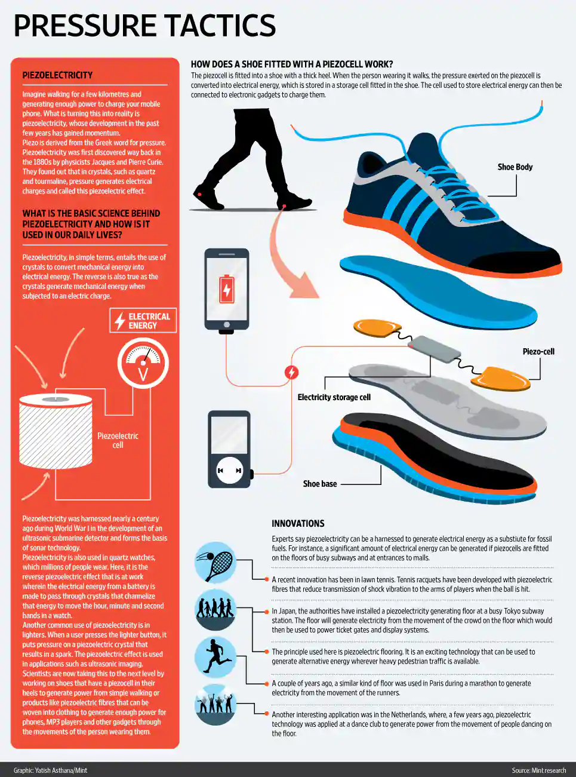
PZTs in Real Life

Slide 15
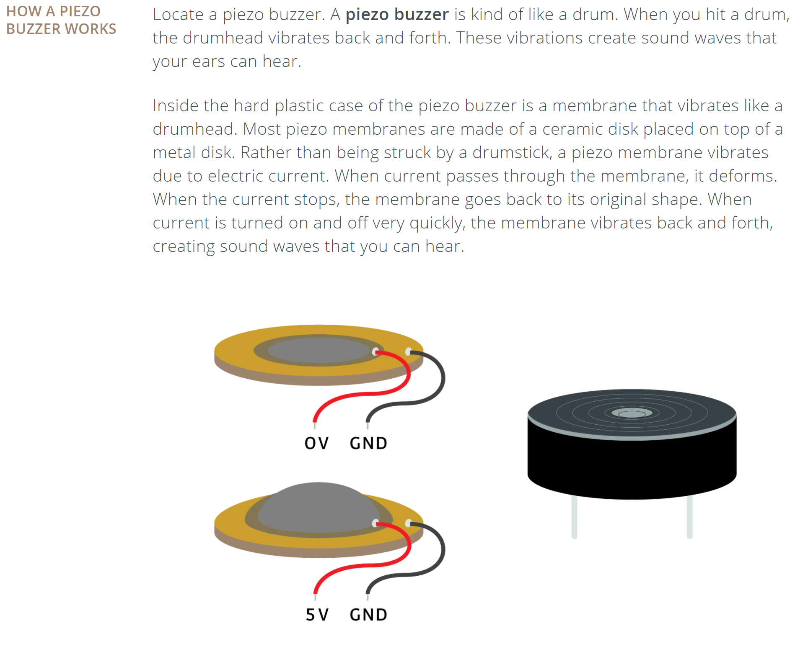
Piezo Buzzer
Need:
Arduino
Breadboard
Piezo Buzzer
Jumper Wires
Power Leads
USB Cable

Slide 16
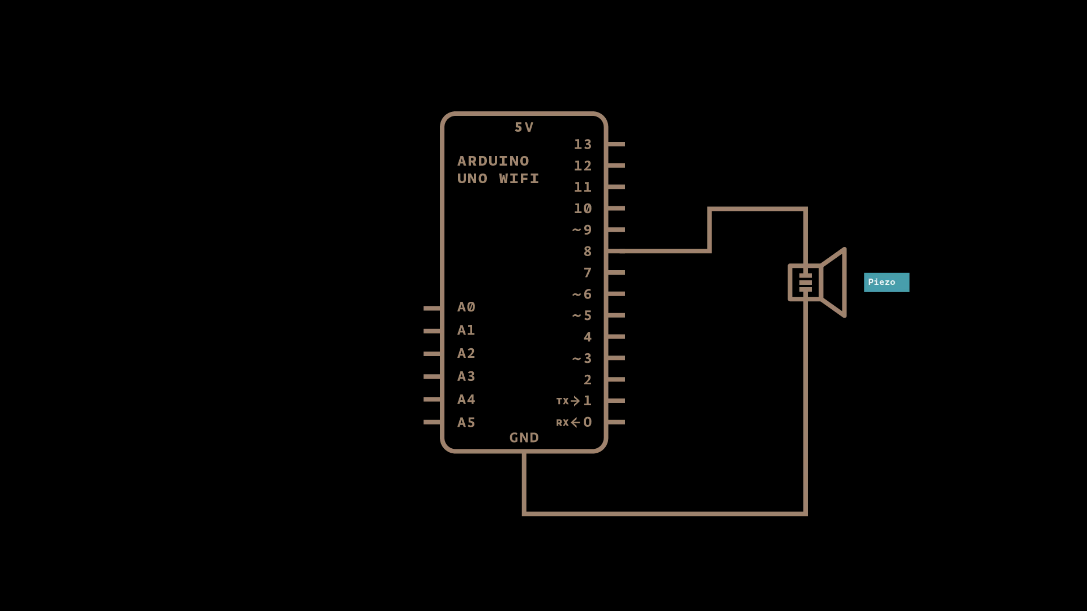
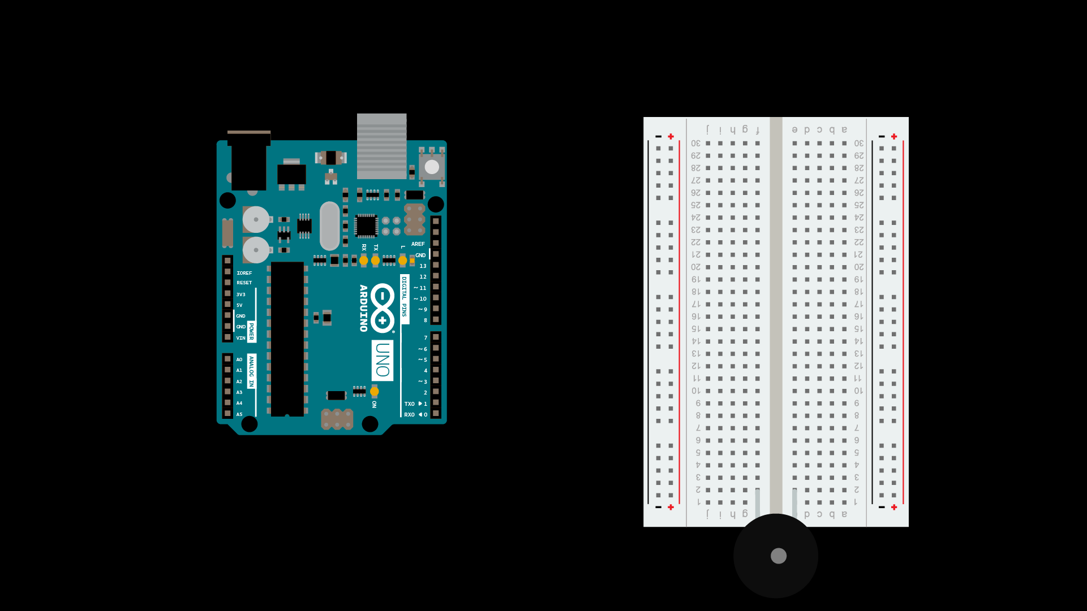
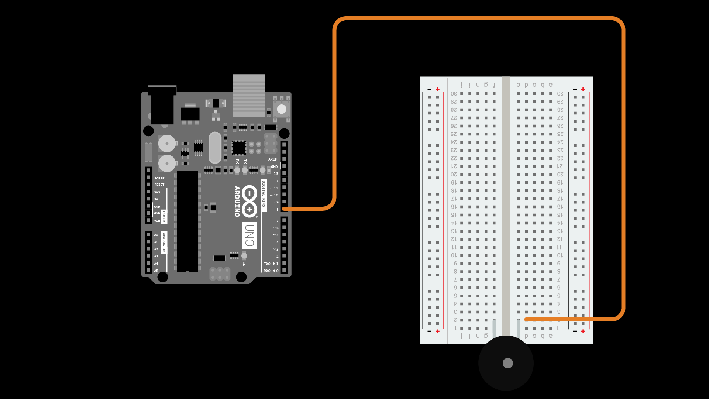
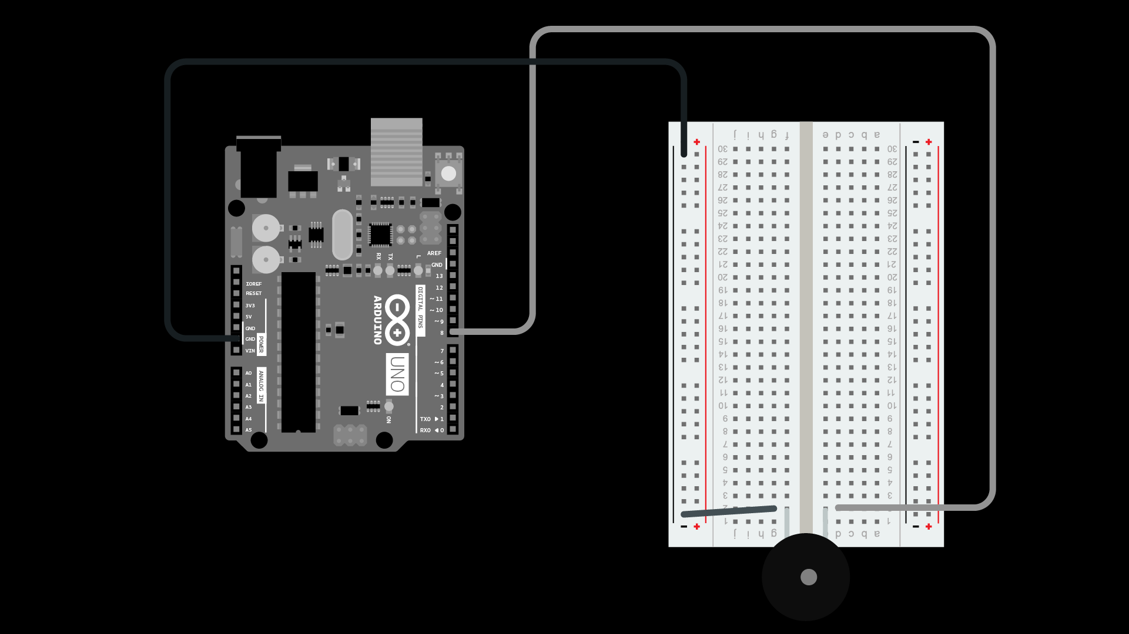
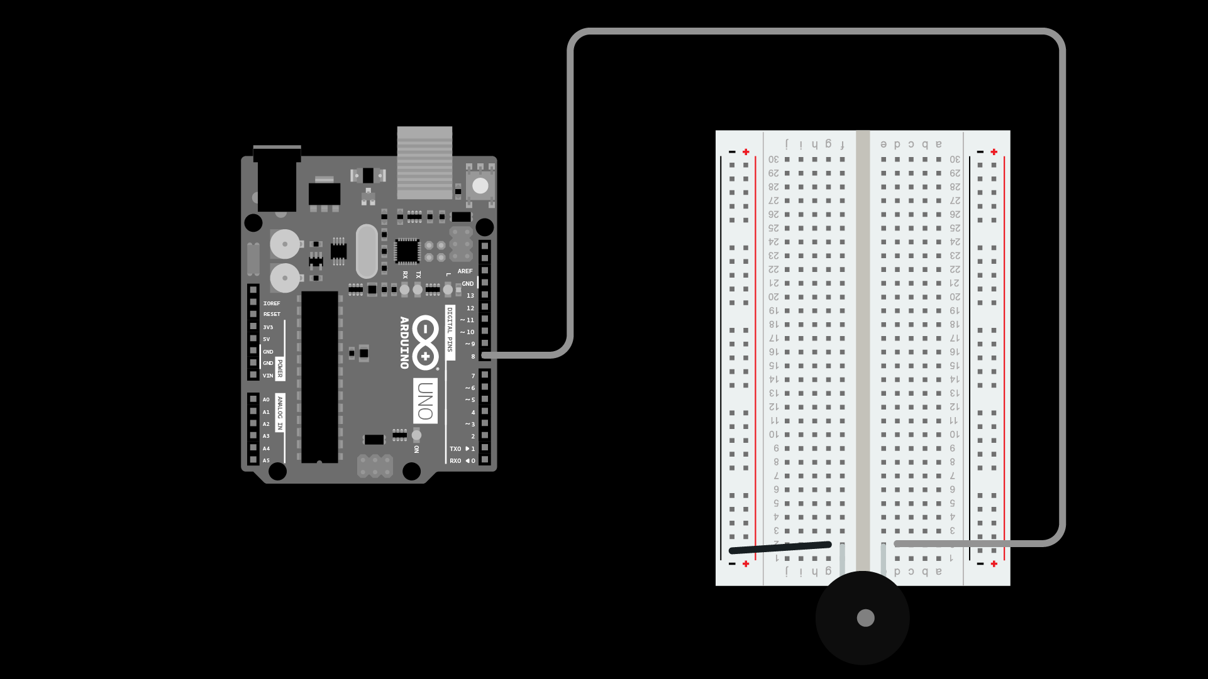
1. Connect PZT to breadboard
2. Connect PZT to pin
3. Connect PZT negative lead
3. Connect Ground

Slide 17
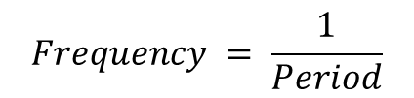
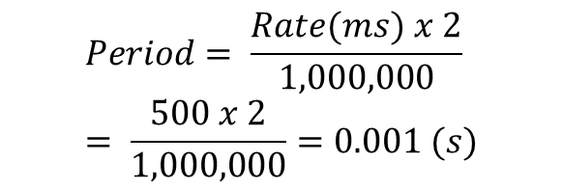
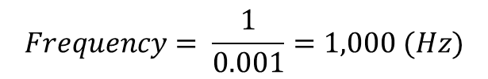
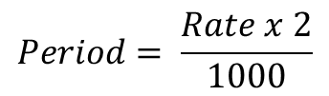
//a. Code: Open Examples -> 0.1 Basics -> Blink
// name the pins used in the circuit
const int buzzerPin = 8;
// declare variables
int rate = 2;
void setup() {
//declare pins used on Arduino as INPUTS or OUTPUTS
pinMode(buzzerPin, OUTPUT);
}
// the loop function runs over and over again forever
void loop() {
digitalWrite(buzzerPin, HIGH); //turn on the buzzer
delay(rate); // wait for one second
digitalWrite(buzzerPin, LOW); // turn off the buzzer
delay(rate); // wait for one second
}
b. Change int rate to 3 and upload
c. Add rate to the code:
int rate = 500;
void loop() {
digitalWrite(buzzerPin, HIGH);
delayMicroseconds(rate);
digitalWrite(buzzerPin, LOW);
delayMicroseconds(rate);
}
d. Add frequency to the code:
int rate = 500;
int frequency = 1000000/(rate*2);
void setup() {
pinMode(buzzerPin, OUTPUT);
Serial.begin(9600); //baud rate
Serial.print(frequency);
}
$$Period= \frac{Rate x 2}{1000}$$
$$Frequency = \frac{1}{Period}$$
$$Period= \frac{Rate(ms) x 2}{1,000,000}= \frac{500 x 2}{1,000,000}=0.001 (s)$$
$$Frequency= \frac{1}{0.001}=1,000 (Hz)$$

Slide 18
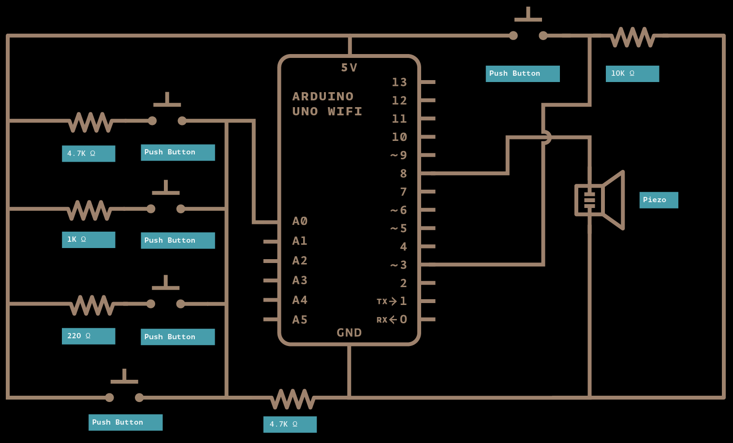
Musical Keyboard
Arduino & USB Cable
Breadboard
1 220 Ω resistor
1 1 kΩ resistor
2 4.7 kΩ resistor
1 10 kΩ resistor
5 push buttons
1 piezo buzzer
Black & Red leads
Jumper Wires

Slide 19
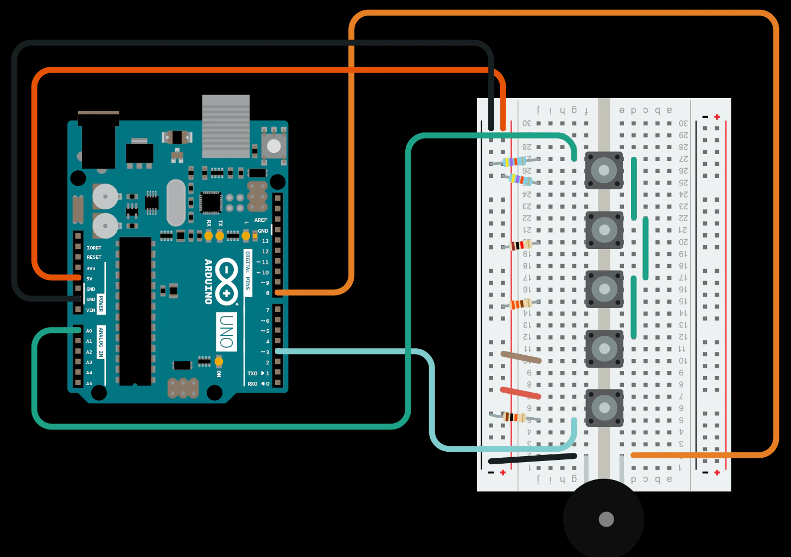
Circuit
Each button represents a note, but there are 8 notes in an octave. To achieve the higher notes use combinations.
Adding in the resistors reduces the voltage resulting in lower analog voltage values.
4.7 kΩ
4.7 kΩ
1 kΩ
220 Ω
10 kΩ

Slide 20
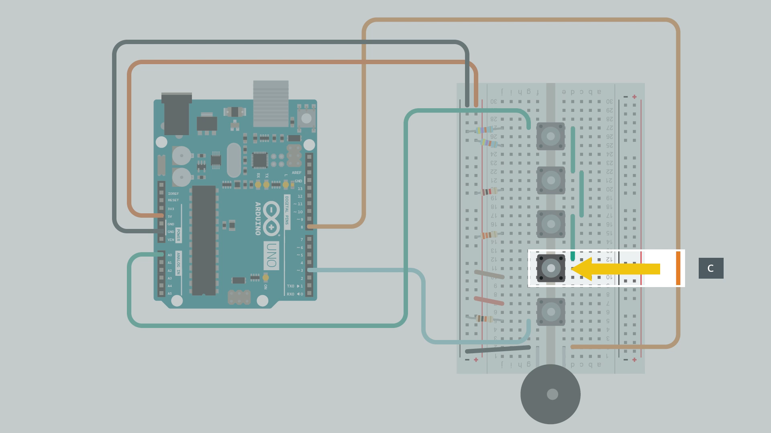

Slide 21
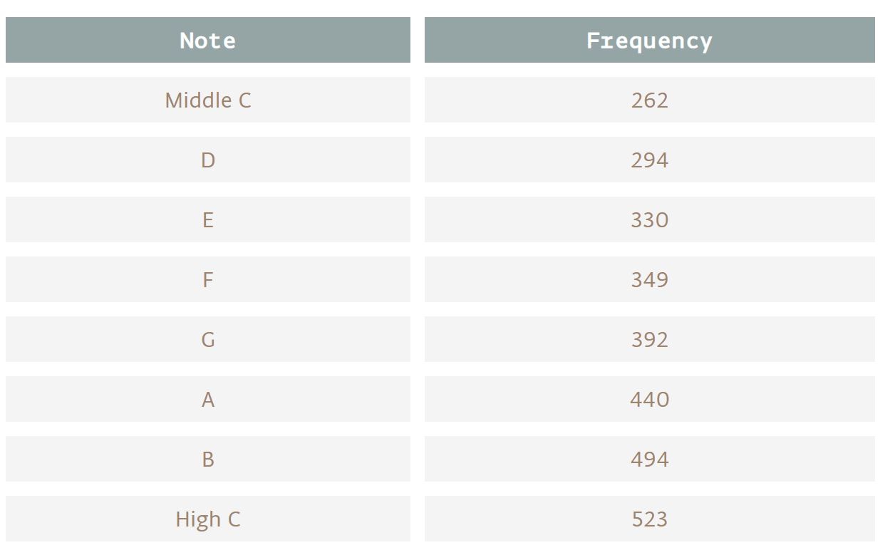
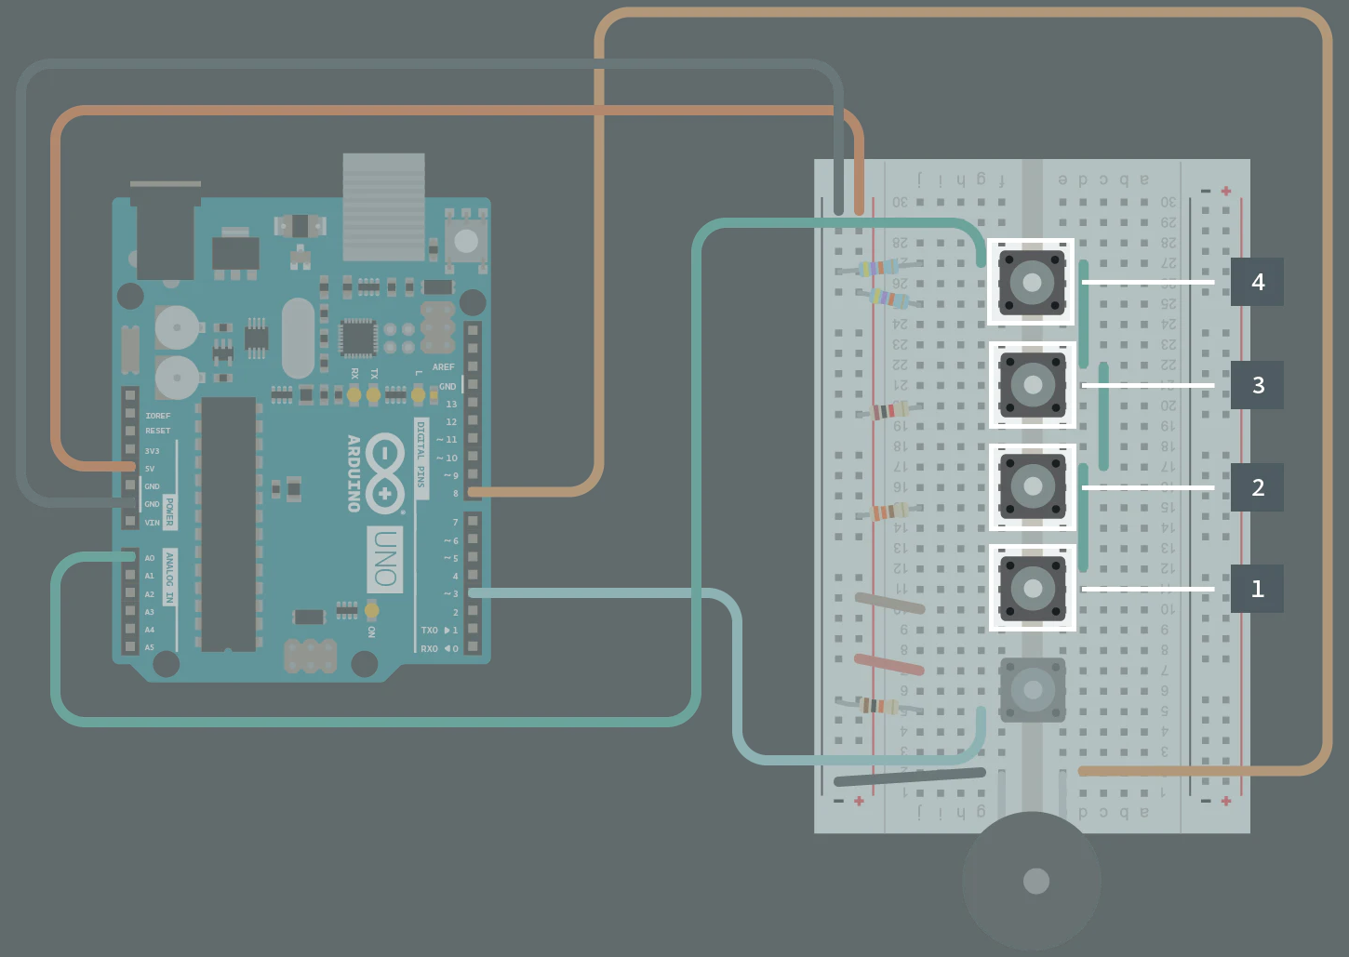
//declare variables
int rate = 500;
int frequency = 1000000/(rate*2);
// name Arduino board pins used by the circuit
const int notePin = A0; //pin connected to the resistor ladder that determines which note gets played
const int togglePin = 3; // the toggle pin determines if the low or high notes are connected
const int buzzerPin = 8; //buzzer pin
//declare variables
int keyVal = 0; //stores the analog value from the resistor ladder
int key = 0; // stores the button that is pressed
int switchState = 0; // stores the state of the toggle button
int note = 0; // stores which note should be played
int oldNote = 0; // stores the previous note that was played
// an array of notes with frequencies of middles C, D, E, F, G, A, B, and high C
int notes[] = {262, 294, 330, 349, 392, 440, 494, 523};
void setup() {
// set up pins as INPUTS or OUTPUTS
pinMode(togglePin, INPUT);
pinMode(buzzerPin, OUTPUT);
// open a serial connection to the computer
Serial.begin(9600);
}
void loop() {
// read the inputs from the Arduino board
keyVal = analogRead(notePin); // analog value of the key
switchState = digitalRead(togglePin); // toggle button state
if (keyVal > 1005) {key = 1;} // first key is pressed
//the button without a resistor should be ~1023, but use a smaller number like 1005 //in case the full voltage doesn’t come through
else if (keyVal > 900) {key = 2;} // second key is pressed
else if (keyVal > 800) {key = 3;} // third key is pressed
else if (keyVal > 400) {key = 4;} // fourth key is pressed
else {key = 0;} // no key is pressed
// determine the note to play based on if the toggle button is up or down
switch (switchState) {
case 0:
// button is not pressed so play low notes (0 through 3)
note = key -1;
break;
case 1:
// button is pressed to play high notes (4 through 7)
note = key + 3;
break;
}
// if a key is pressed, play the corresponding sound
// otherwise don’t play anything
if (key > 0) {
tone(buzzerPin, notes[note]);
}
else {
noTone(buzzerPin);
}
// display information only when the note changes
if (note ! = oldNote) {
Serial.println(“toggle state: analog value : note”);
Serial.print(switchState);
Serial.print(“ : “);
Serial.print(keyVal);
Serial.print(“ : ”);
Serial.println(note);
}
oldNote = note;
}

Slide 22
Stand Ups
What did you learn this week?
What do you need help with/ what would you like to know more about?
What do you think this lesson would be useful for?

Slide 23
Resources
Arduino tutorials: https://www.arduino.cc/en/Tutorial/HomePage?from=Main.Tutorials
MIT’s Scratch program is a great stepping stone that uses block coding, allowing you to learn the structure of programming before learning the actual languages themselves.
Code.org provides numerous resources connected to coding for those interested in learning the basics.
Code Academy is an interactive guide to learning multiple languages like JavaScript, HTML/CSS, and more.
Khan Academy has instructional courses on computer programming and computer science, it is an especially good resource for learning how to animate with code.
Also if you have any computer science classes offered at your school, I highly recommend taking them.
Typershark or any basic typing tutorial/software/class. Might seem boring, but proper typing skills will pay off in the future a thousand times over – you don’t want something so simple holding you back!
Maybe robotics and programming isn’t as interesting as you thought it would be, or maybe it’s just not enough! Explore these adjacent fields: Data Science, Robotics, Graphic Design, Engineering, Cybersecurity, Hacking, Machine Learning, Natural Language Processing, Network Design, Website creation.

Slide 24
Backup Material
Fei-Fei Li: How we are teaching computers to understand pictures. https://www.ted.com/talks/fei_fei_li_how_we_re_teaching_computers_to_understand_pictures?language=en

Slide 25

Women in Tech Spotlight: Tan Le
Accomplishments
Tan Le is the CEO and founder of Emotiv - a bioinformatics company.
The company is exploring a new “remote control” where a headset uses EEG technology to control digital devices by reading brain activity.
She is a refugee from Vietnam at age 4, she entered college at 16 and has since become a vital young leader in her home country of Australia. She attended Monash University in Melbourne, Australia where she studied law and commerce.
https://www.ted.com/talks/tan_le_a_headset_that_reads_your_brainwaves

Slide 26

Women in Tech Spotlight: Fei Fei Li
Accomplishments
Current director of Stanford Artificial Intelligence Lab, as well as the Stanford Vision Lab, Head of Google Cloud AI
B.S. in Physics from Princeton, with High Honors
PHD in Electrical Engineering from Cal Inst. Of Tech
2011 Sloan Fellowship recipient (43 fellows have gone on to win Nobel Peace Prizes)
Currently working to solve AI’s trickiest problems, including image recognition, learning, and language processing
Also works in cognitive neuroscience: studies how human brains work in order to apply those lessons to teaching machines to learn better
https://www.ted.com/talks/fei_fei_li_how_we_re_teaching_computers_to_understand_pictures

Slide 27
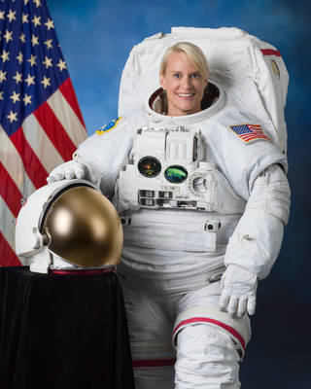
Women in Tech Spotlight: Kate Rubins
BS in Molecular Biology from University of California, San Diego
PhD in Cancer Biology from Stanford University Medical School
Fellow/Principal Investigator of a Lab at the Whitehead Institute for Biomedical Research of MIT studying viral diseases that primarily affect Central and West Africa and conducted research in the Democratic Republic of Congo
Selected to the Astronaut Corps in 2009
Expeditions 48 and 49 participating in more than 275 different scientific experiments
First person to sequence DNA in space, sequencing over 2 billion base pairs of DNA
Performed 2 space walks, including installing the new International Docking adapter, a new docking port for the US commercial crew spacecraft (i.e. the SpaceX flight that took place earlier this year)
Currently on board the International Space Station for Expedition 63/64
https://www.nasa.gov/astronauts/biographies/kathleen-rubins/biography

